Slide 1
Object pronouns
Basic 5 – Unit 2 Lesson B

Slide 2
Subject
It performs /does the action.
Teacher Johan is reading a book.
Object
It receives the action.
Teacher Johan is reading a book.

Slide 3
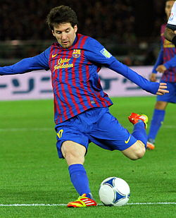
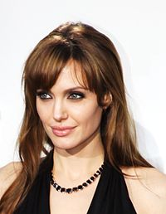
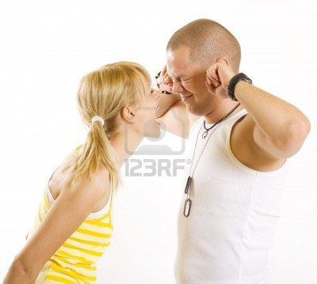
Object Pronouns in English
Messi plays soccer.
Subject
Object
it.
He plays .
Subject
Object
Luis and Juan like Angelina Jolie a lot.
Subject
Object
her
They like ______ a lot.
She is shouting at Carlos.
Subject
Object
him.
She is shouting at
Subject
Object

Slide 4
Anne is taking her books to the library. She is carrying (they, them)
He is writing a song for (she, her).
Betty is staying home and (she , her) is getting some rest.
Ann foot hurts when (she, her) walks.
Anna's mom says (she, her) is disorganized
Helen is making a blue sweater for (she, her)
Jan is not at work today because she is here with (I, me)

